Slide 1
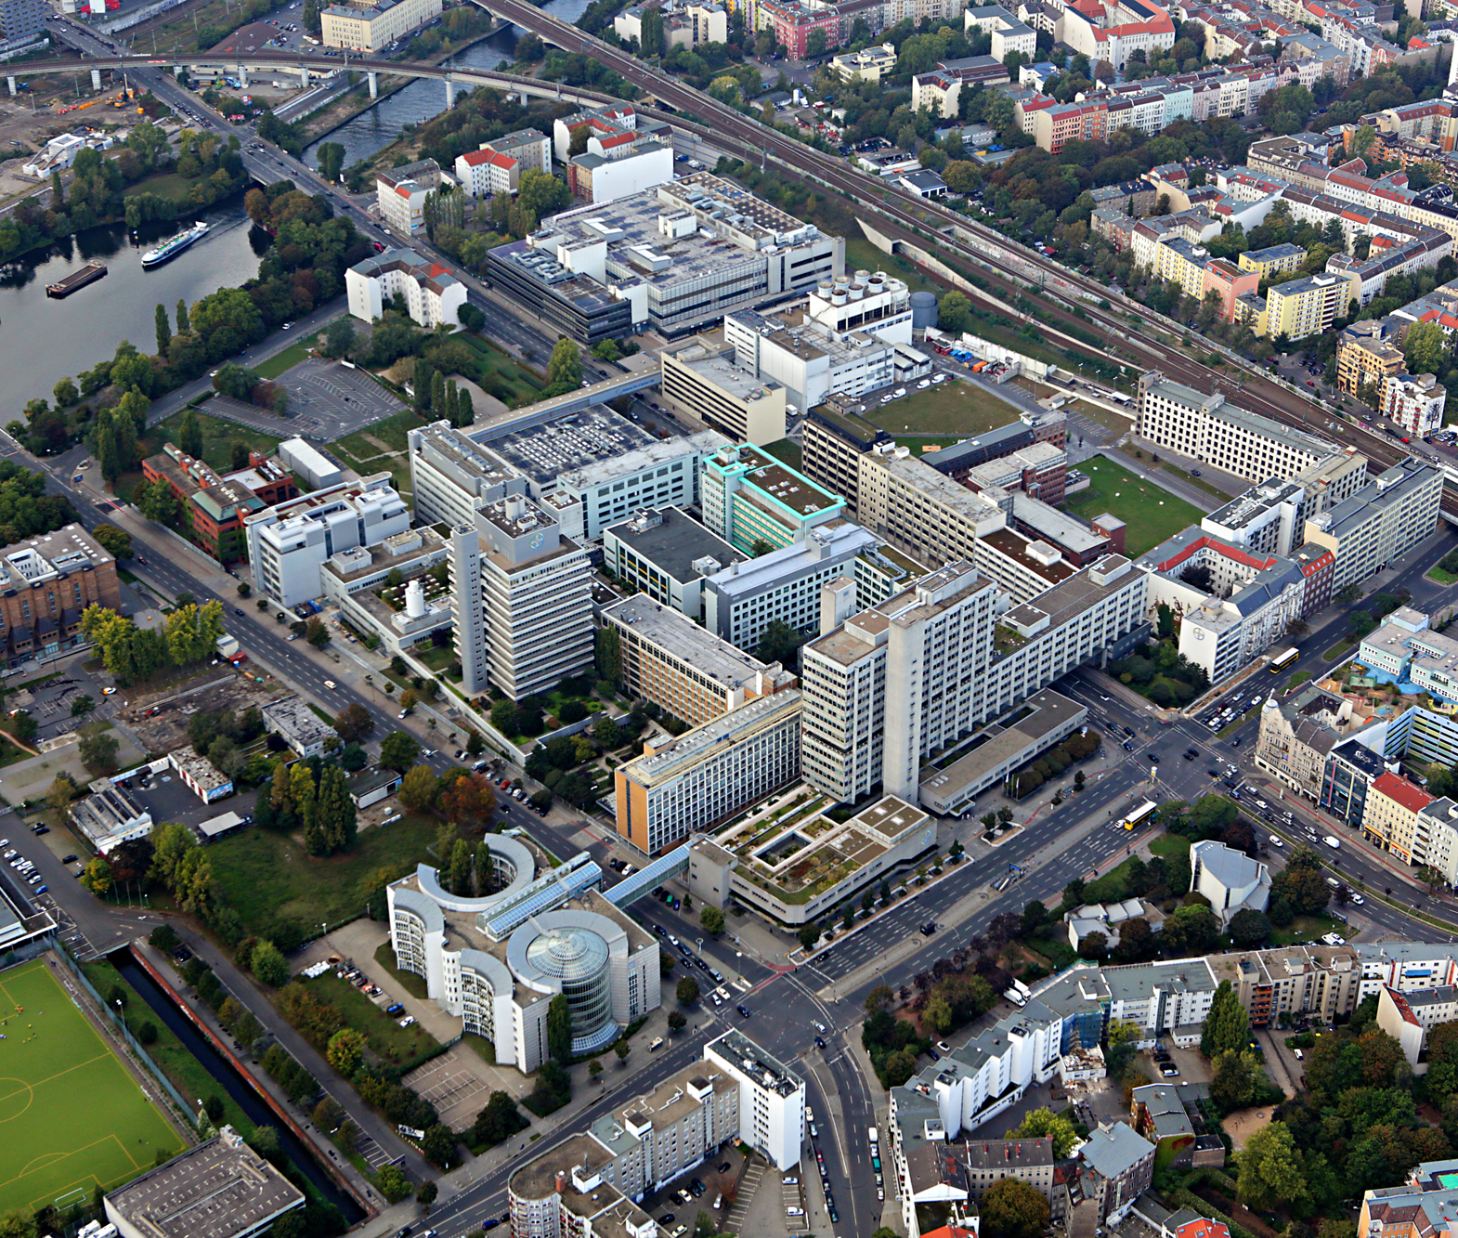
AI Solution for E-Invoice Document Management
Zhixian Zhang

Slide 2
Agenda
Project Background
Project Overview
Project Details
Next Steps

Slide 3


Current EDM manual checking is time consuming
Collaborate with Commercial E-Invoice Document Management (EDM) Department, responsible for auditing conference files.
1000+ conferences every year
25-50 pages pdf file for each conference
60+ mins for each file to be checked
6 personnels involved
Notes:
当前edm处理很耗时
[Yesterday 5:03 PM] Derek Lan
就是我们一共去年是1694个会议，其中包括class c 和po。咱们做这个是class c 但是其实PO可以直接拿来用。每个人每个会议 我们现在是class c按照60mins 然后Po 是30mins计算的。一天要check多少个 这个没有个说法 有的时候好几天没有 有的时候一天7 8 个。
[Yesterday 5:05 PM] Derek Lan
1694 class c 能有个1153个

Slide 4






Technical Framework
Business Value
Photo OCR Text Extraction
Data Processing
Efficiency: Reduce labor cost of conference invoice files auditing. Increase the efficiency by 50%+
High Resolution Image Extraction
ChatGPT-4o
ChatGPT Response (Text/Code)
Web Page
Prompts
Prompts
Prompt Engineering
Accuracy: Utilize most recent advances in NLP domain to enhance accuracy for invoice checking
……
Key point Checklist
Prompts
大发票与结算单总金额是否一致
结算单与报价单会议名称，地点，时间是否一致
报价单中盖章是否存在
Opera确认邮件中发件人，收件人与会议详情是否存在
结算单中各发票金额是否与小发票中一一对应
Reusability: Enable future system-wise integration such as connection with Opera
Notes:
打开pdf文档
梳理了一些比较heavy的检查点

Slide 5
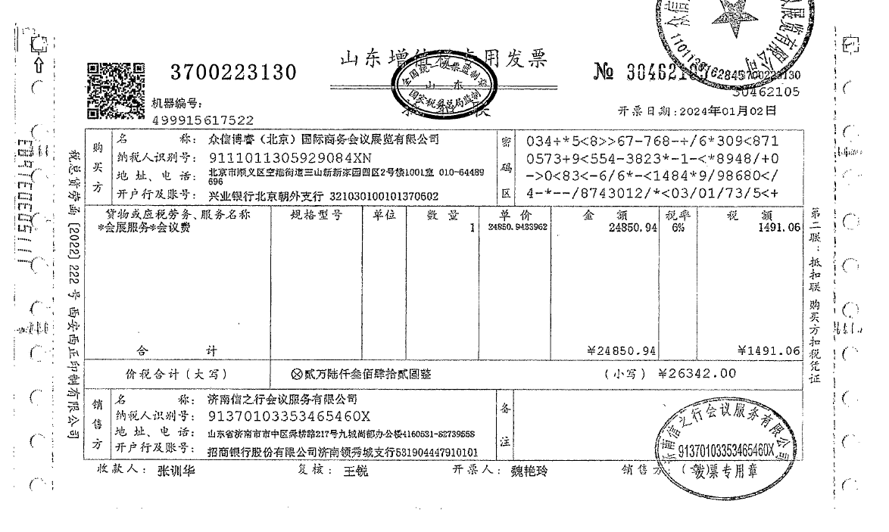
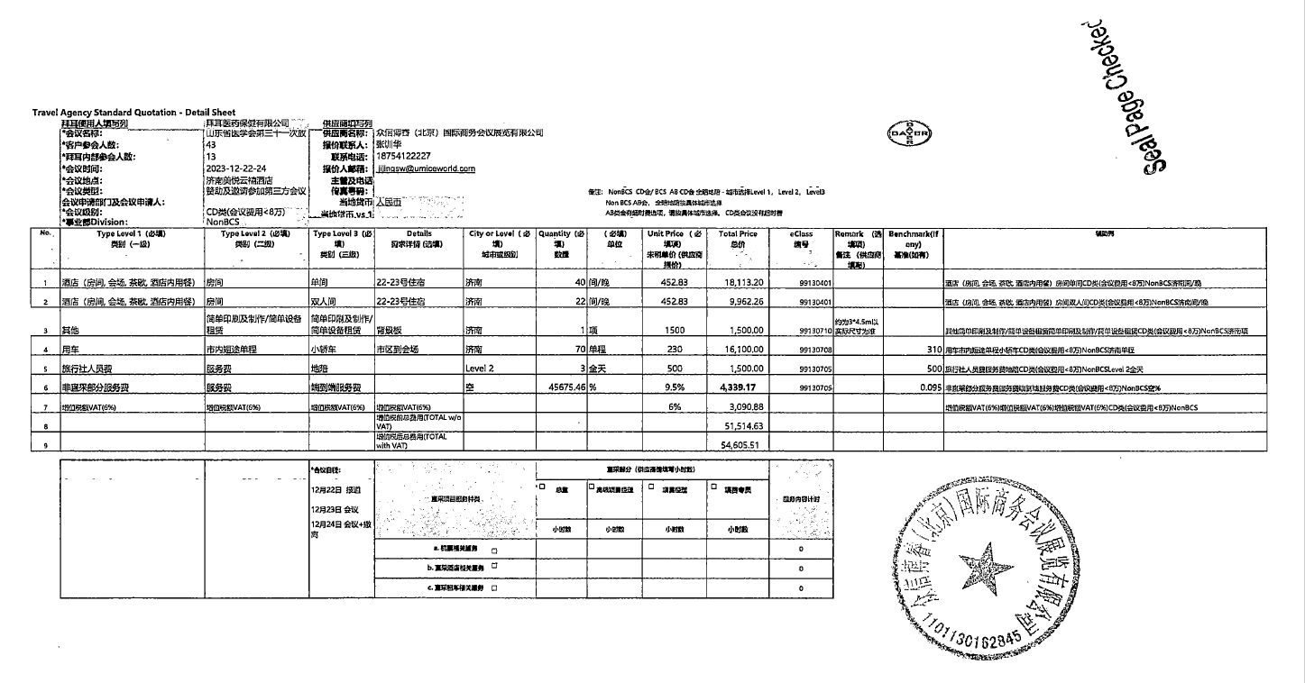
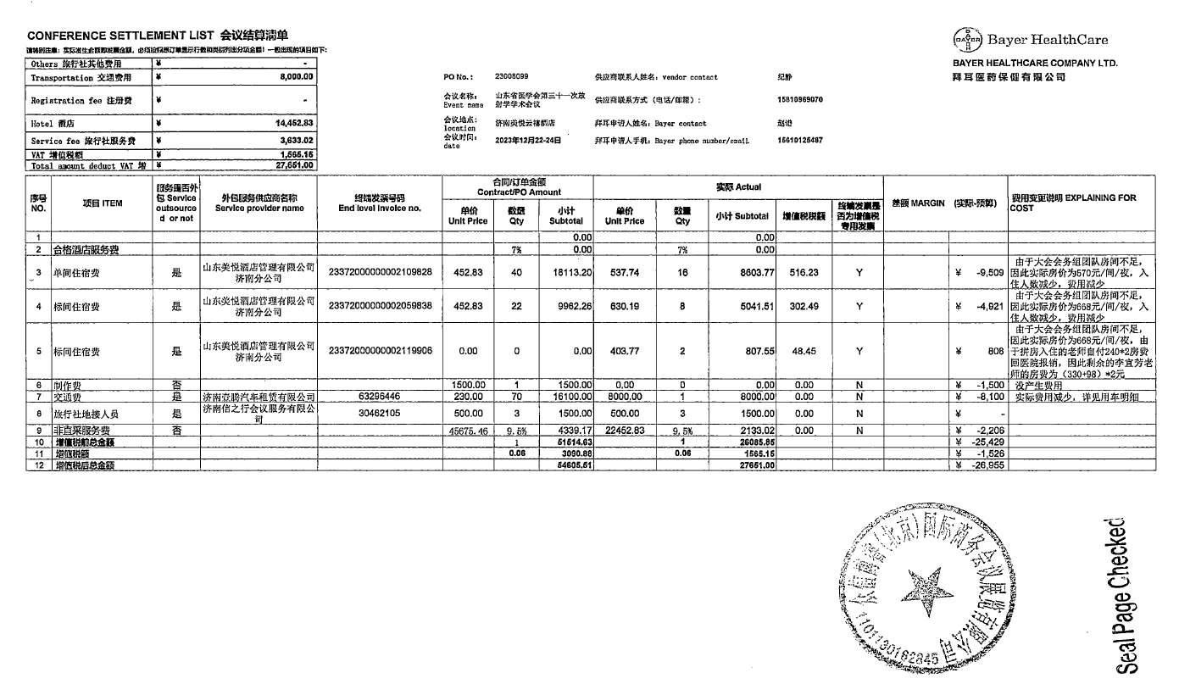




Main challenges come from input data
CHALLENGE
APPROACH
Low data quality. Scanned printed version of invoices and sheets, with blurry stamping
Unordered pages, lack of crucial words that helps identifying the target pages
Large number of forms/numbers, high demand on model accuracy
Framework Design: Tried different combinations of models and compared the performance. Resulted in the one with the best performance: OCR and GPT.
Model Selection: Compared different large language models to see the performance of information extraction: GPT 4 turbo, GPT 4-vision preview, GPT 4o, Claude 3. Resulted in the model with best accuracy-time balance: GPT 4o
User Experience: Meet with EDM colleagues regularly to acquire user experience and feedback. Then update our model for better generalization.
5
Notes:
其中，主要challenge是数据维度的

Slide 6
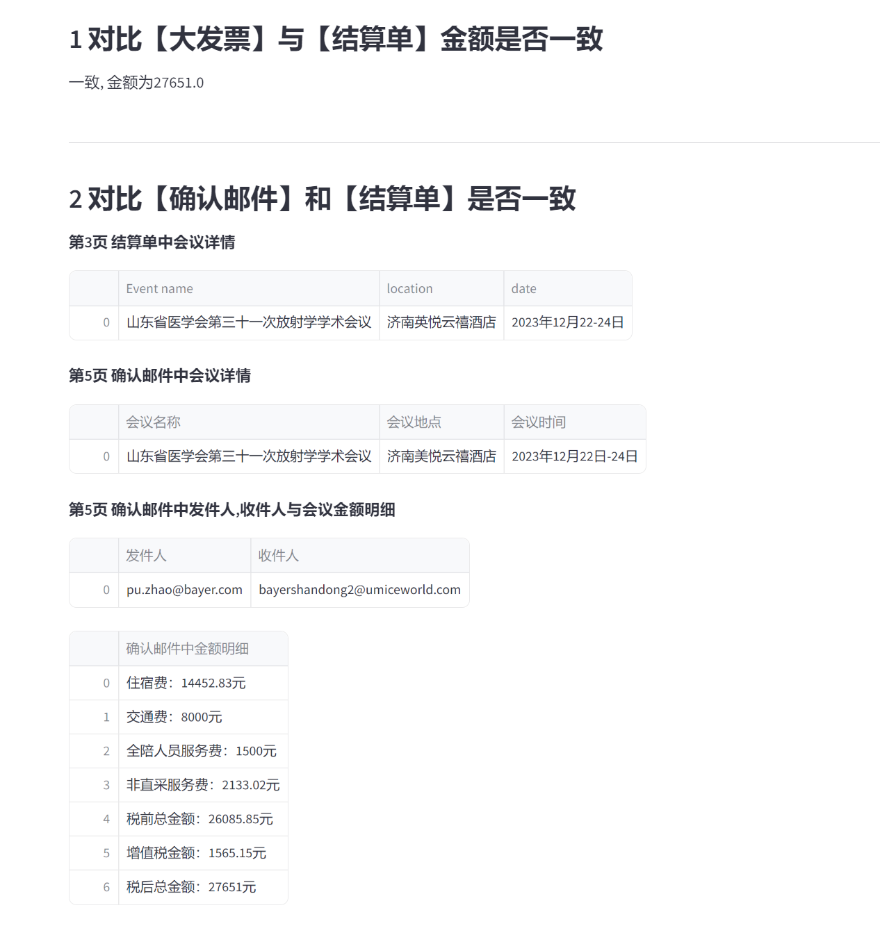
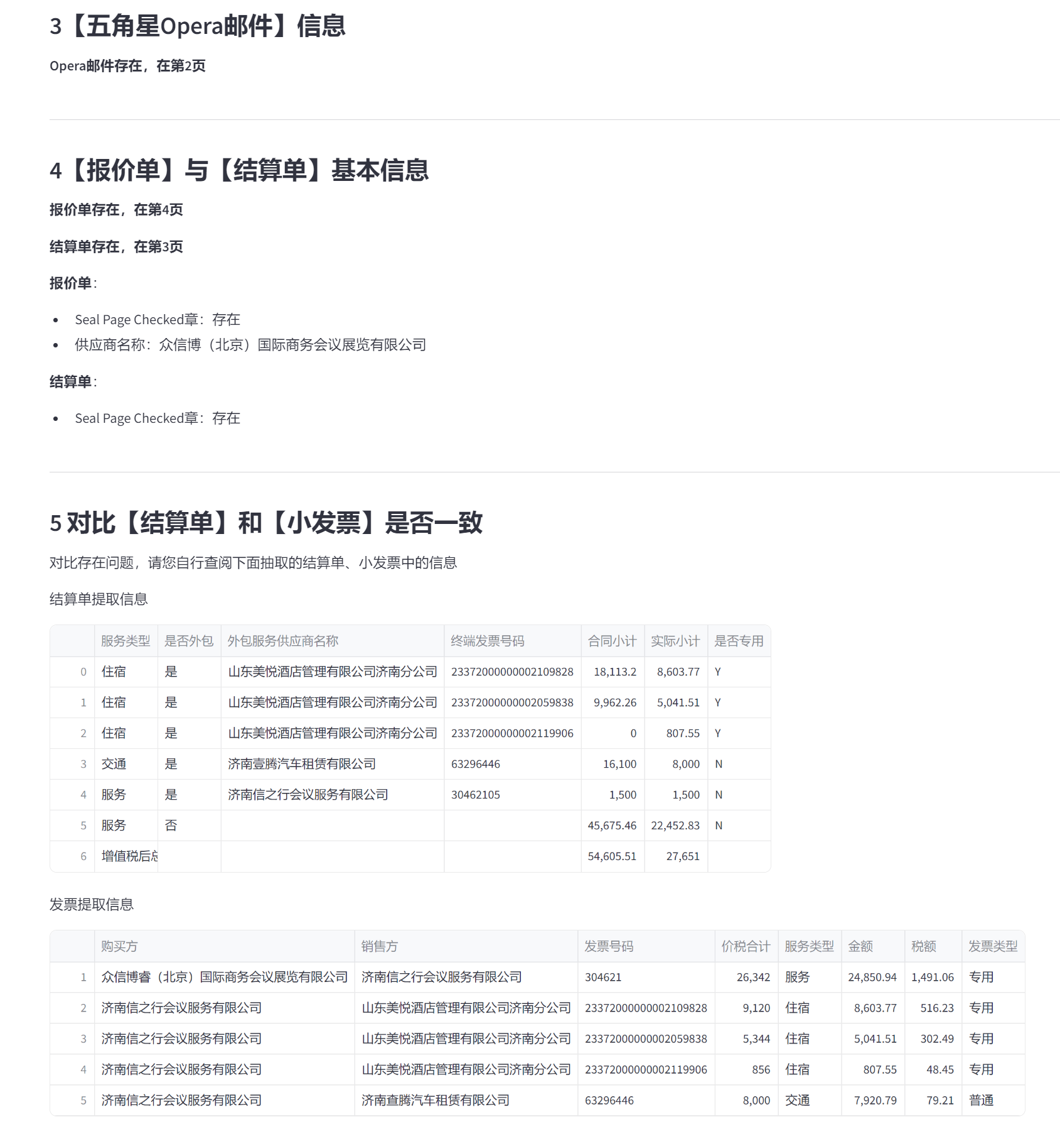
Our project outputs a user-friendly web interface
60mins -> 15mins
6
Notes:
Our project outputs a user-friendly web interface

Slide 7
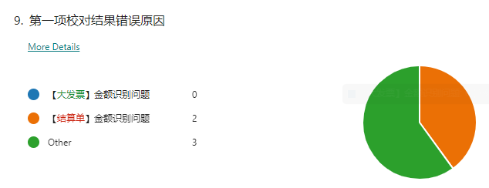
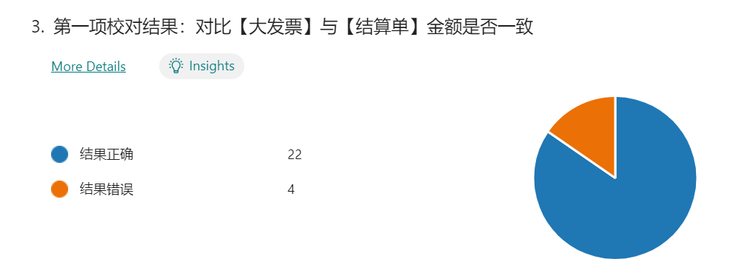
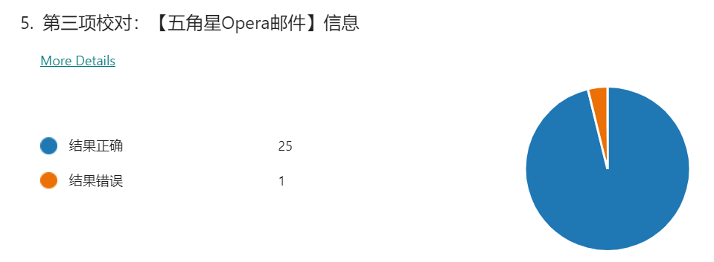
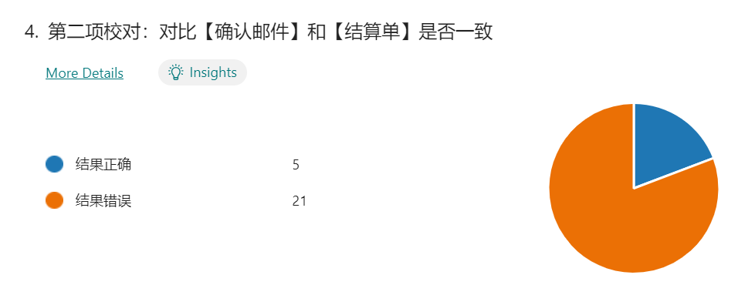
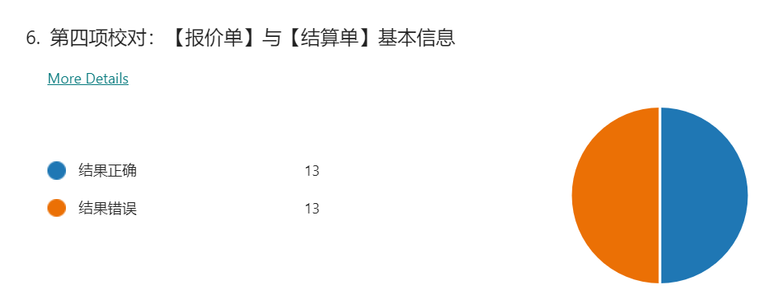
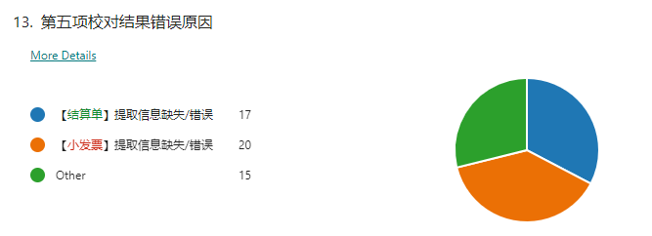
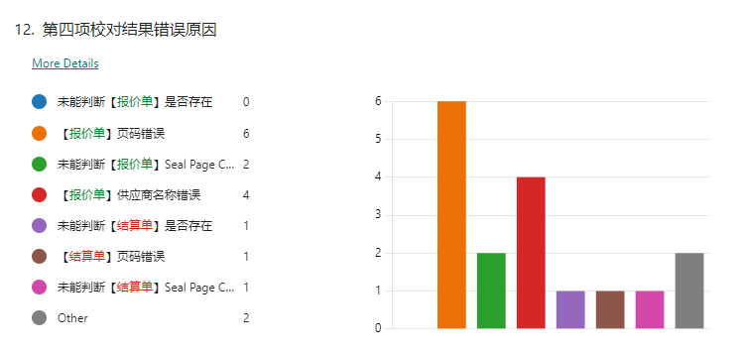
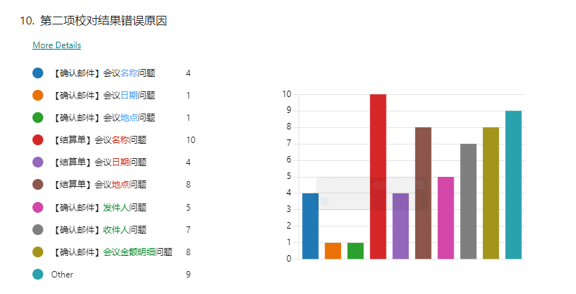
We conducted detailed UAT. Some reached expectation but some still needs further optimization
7
Notes:
We conducted detailed UAT. Some reached

Slide 8

Next Steps
Performance: Increase accuracy based on UAT feedback
Production: Opera integration

Slide 9

Thank you!
Bye-Bye

